Slide 1
Unveiling Teacher 2.0
IMPACT FOUNDATION
2021
Updated with Latest Tools..!
By
Suresh Gutur

Slide 2
Agenda:
Introduction
Offline Education vs Online Education
General Presentation Tools
Teaching Tools Recommendation
Controlling Online Classes
Other Useful Apps for teachers
Need of Social Presence?
Your Greatest Weapons to get content for teaching
Conclusion

Slide 3
Offline Education
traditional training! Where a student needs to go in a school, in a classroom, and attend a class face to face with a teacher.
Benefits of Offline Education | Disadvantages of Offline Education
Individualized monitoring | Fixed location
Structured & disciplined setting | Fixed schedule
Face to face interactions | Study materials
Interpersonal skills development | Dependency on the teachers
Competitive atmosphere | Transport & Accommodation

Slide 4
Online Education
A very flexible learning system that allows students to study solely via the internet on their own computer at home, or wherever they see fit.
Benefits of Online Education | Disadvantages of Online Education
Location doesn’t matter | Isolating
Flexible hours | Must have self discipline
Time saving | No interpersonal skills development
Cheaper | Limited topics
Convenient
Class can be recorded

Slide 5




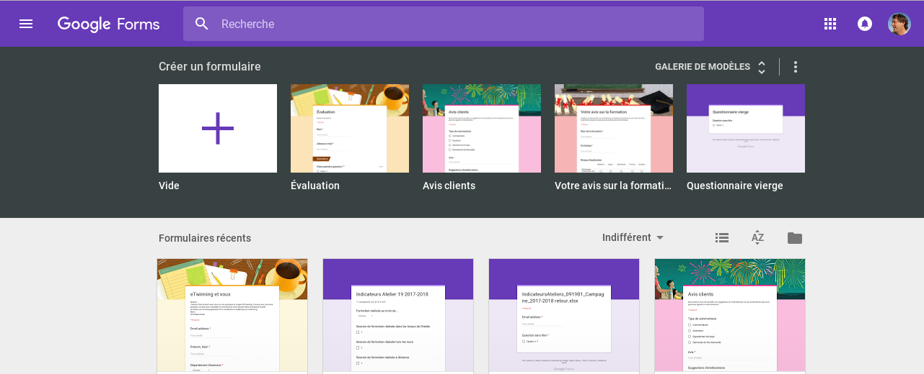
General Tools
Power Point Presentations
Microsoft Word & Excel Sheets
Audio & Video aids
Google forms
For Documenting,
Focusing, Managing,
Aggregating, etc

Slide 6





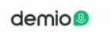
Teaching Tools Recommendation

Slide 7
Controlling Online Classes
Hold yourself accountable
Practice time management
Create a regular study space
(Internet, headphones, materials) stay organized
Eliminate distractions
Increase student engagement.
Follow Microlearning Principles
Assignments & Breakout Groups
Leverage your network
Notes:
( Ex: 6-year-olds can pay attention to a subject for 12 to 18 minutes. On the other hand, 12-year-olds can pay attention for 24 to 36 minutes)

Slide 8
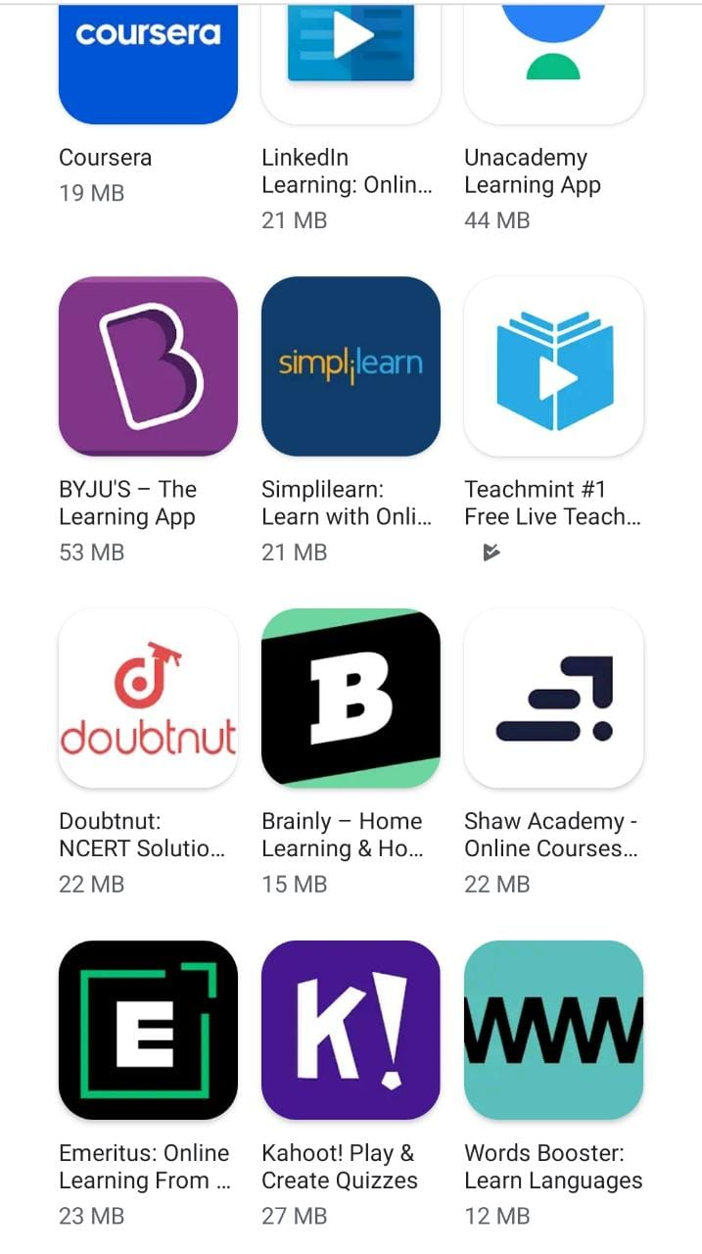
Other Useful APPS
https://www.mathsisfun.com/index.htm
https://www.desmos.com/calculator
https://whiteboard.fi/x697k
https://www.mathwhiteboard.com/
https://www.khanacademy.org/
https://www.edx.org/
https://ocw.mit.edu/
Other Useful Websites

Slide 9

Do you Need Social Presence?

Slide 10


Your Greatest Weapons

Slide 11
THANK YOU!
Suresh Gutur
Phone
9493 2040 94
Email
suresh.gutur9@gmail.com

